Slide 1
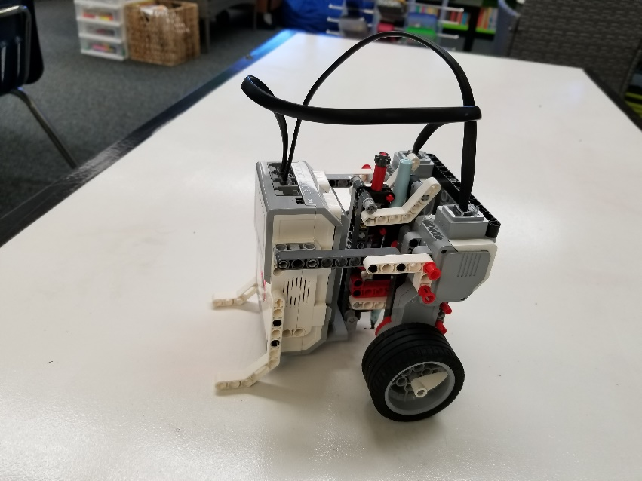
Using a Drawing Robot to Make Angles (Using Rotations)

Slide 2
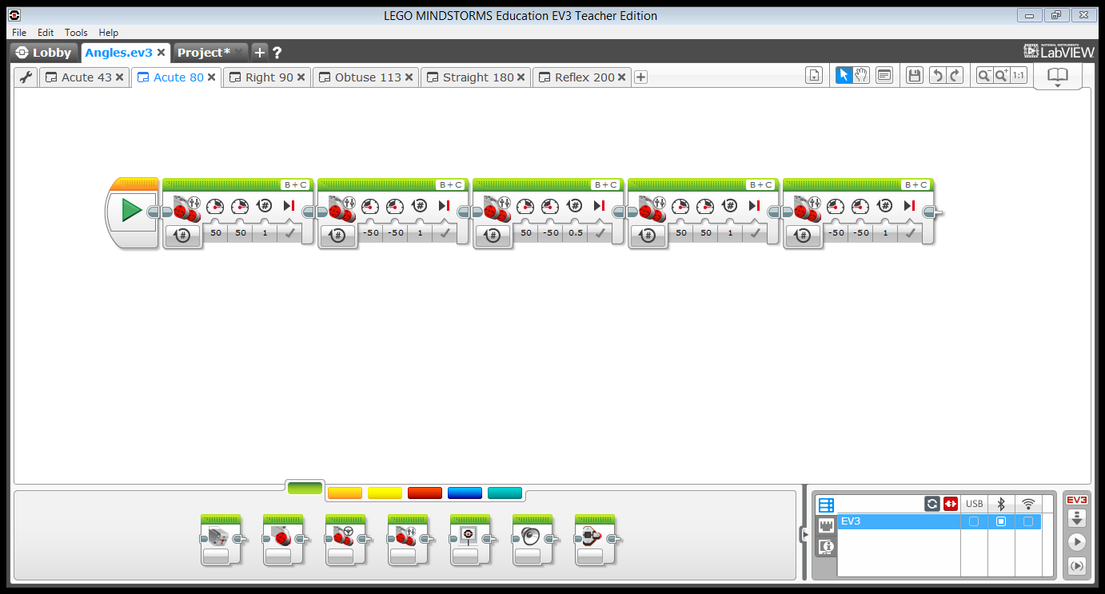
Programming With Rotations

Slide 3
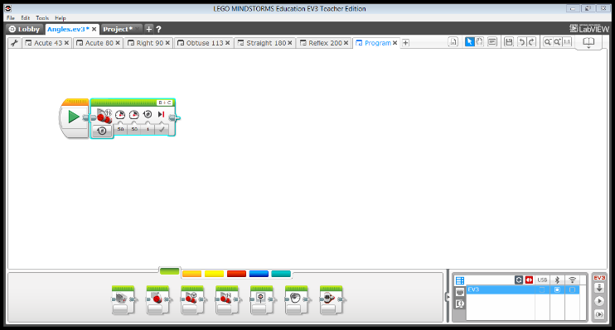
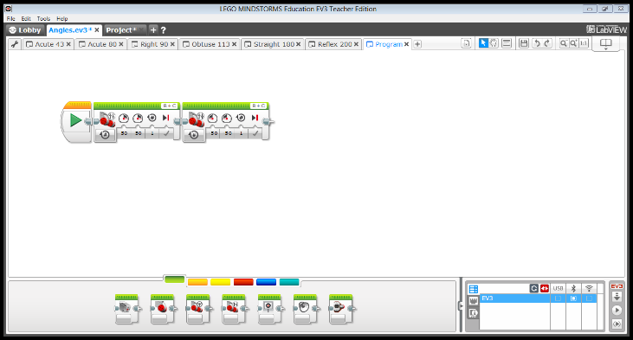
Use Tank Move Block to Draw a Line Segment
Have the robot move at least one rotation forward.
Have the robot move at least one rotation backward by adding negative values to the B and C motors.

Slide 4
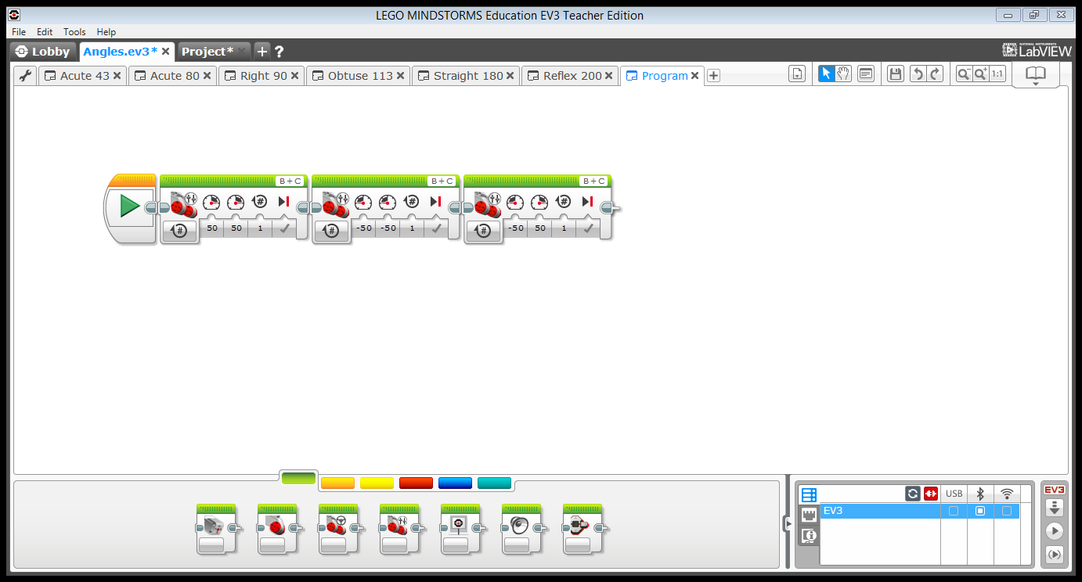
Make a Point Turn Using the Tank Move Block
Change the number of rotations to change the degree of the angle
One motor moves forward and the second motor moves backward

Slide 5
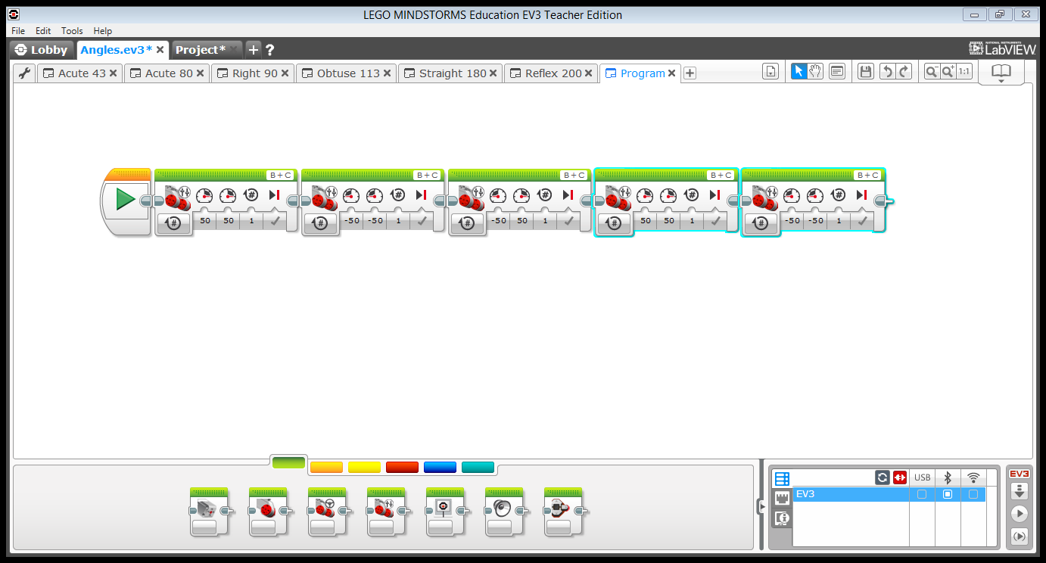
Now make another line segment to complete the angle……

Slide 6
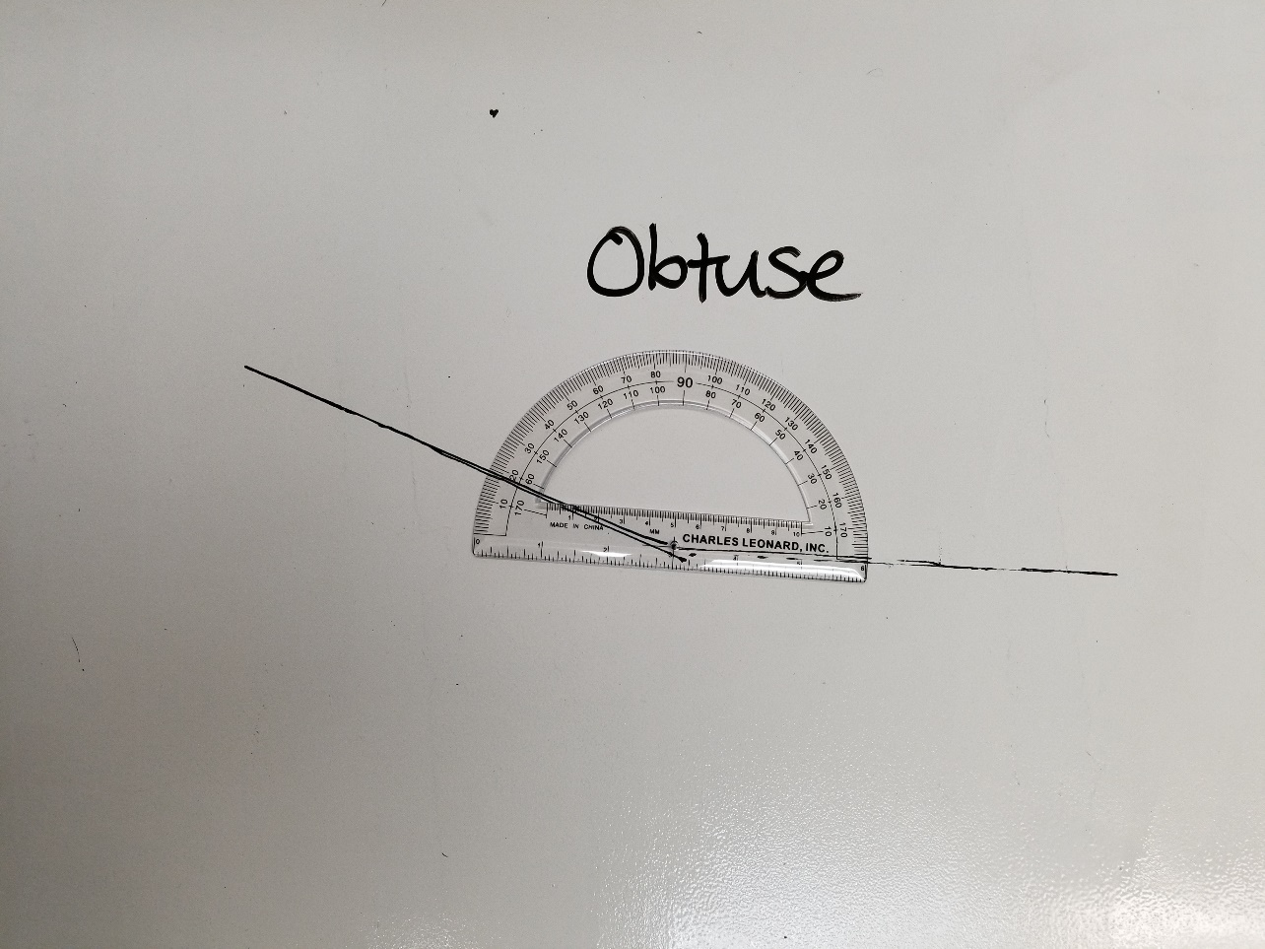
Obtuse Angle

Slide 7
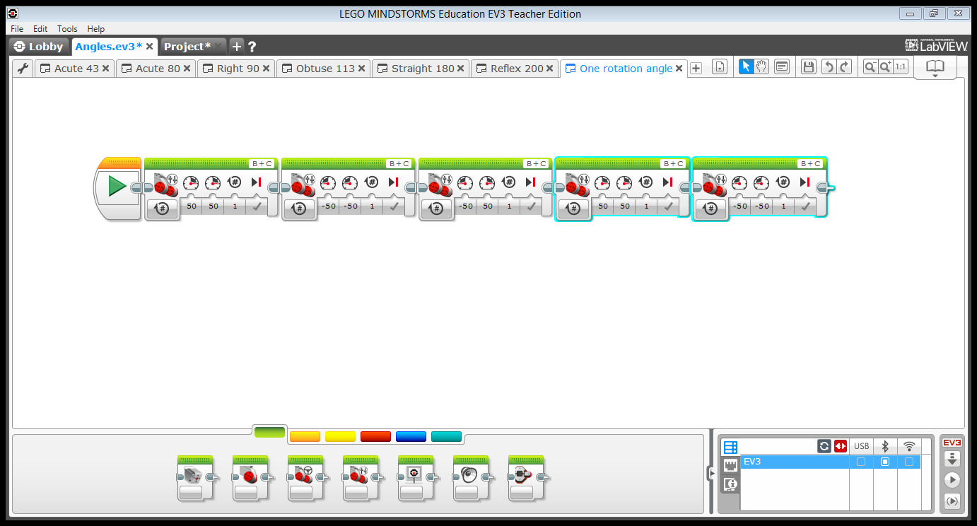
Change the Angle
Use tenths and hundredths to make smaller angles

Slide 8
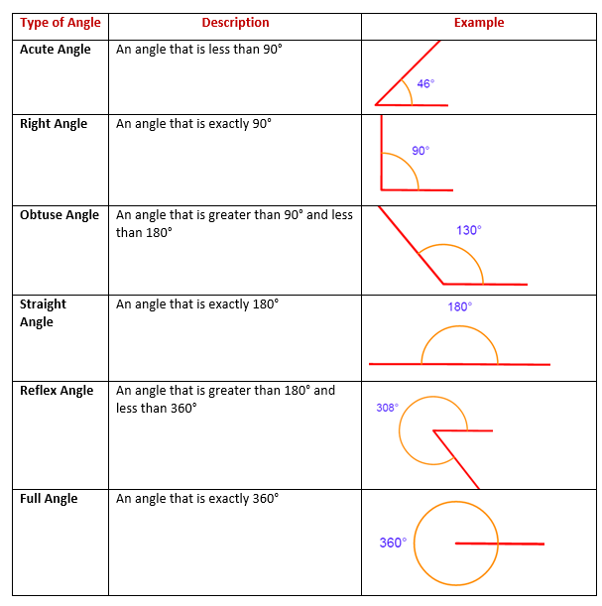
Different Types of Angles
How many types of angles can you make?
How to Measure an Angle Part 1
How to Measure an Angle Part 2

